Slide 1

Ishan Singh 1JS18CS064

Slide 2
Problem Statement
Concrete is the most important material in civil engineering. The concrete compressive strength is a highly nonlinear function of age and ingredients. These ingredients include cement, blast furnace slag, fly ash, water, superplasticizer, coarse aggregate, and fine aggregate.
I will be analyzing the features and build a regression model that will be used to predict the strength of concrete.

Slide 3
Steps Followed
Data Preprocessing
Feature Selection
Model Selection and Evaluation
Hyperparameter Tuning

Slide 4
Data Preprocessing
Checking for Null Values
The features in the dataset has got no null values therefore no need to perform any methods to deal with missing values.
Removing Outliers
Replaced outliers of a particular feature by the median of that feature.

Slide 5
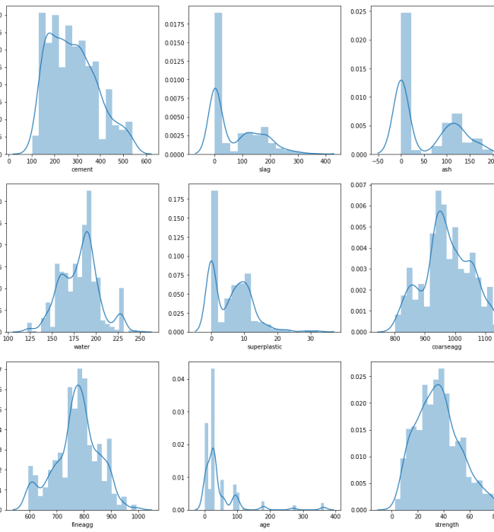
Multivariate Analysis
Used Distplot that shows a histogram with a line on it. The line helps to determine what kind of distribution is the plot.
Observations:
cement is almost normal.
slag has three gausssians and rightly skewed.
ash has two gaussians and rightly skewed.
water has three guassians and slighly left skewed.
superplastic has two gaussians and rightly skewed.
coarseagg has three guassians and almost normal.
fineagg has almost two guassians and looks like normal.
age has multiple guassians and rightly skewed.

Slide 6

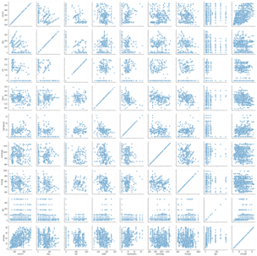
Pairplot(Used to plot density curve)

Slide 7
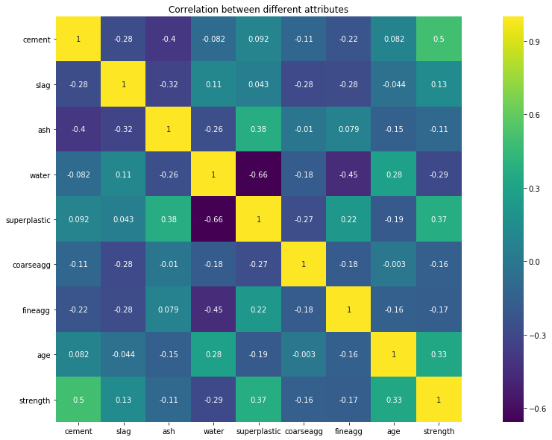
Analyzing correlation between features using heatmap.
To understand Correlation between variables better, we can plot heatmap.
We can extract best features for the model using the heatmap.
Advantages of Feature Selection:
Reduces Overfitting
Reduces Training Time
There is multicollinearity because water is correlated to superplastic therefore we can remove one of them. I have removed water feature.

Slide 8
Standardizing the features and splitting
I have divided taken 70% data as training and 30% as test data.
We also have to take care of data leakage therefore the standardization should be performed separately on training data and test data.

Slide 9
Models Implemented and Accuracy Achieved
RandomForestRegressor – 84.8%
KNN Regressor- 70.98%
Multiple Linear Regression- 65.7%
Support Vector Regressor – 65.17%
Random Forest Performs the best therefore to get better results I have implemented hyperparameter Tuning on this model.

Slide 10
Hyper Parameter Tuning On Random Forest
Hyperparameters are the values that that the user gives to the model.
These features are very important and can decide how well the model can learn.
Examples of Hyperparameters: Learning Rate in gradient descent, number of layers in a neural network.
Using Randomized SearchCV the improvement of accuracy was 1.8%.
Therefore Final Accuracy achieved – 86.56%.

Slide 11




Thank You

